Slide 1
Google Products

Slide 3
Products
https://www.google.com/about/products/

Slide 4
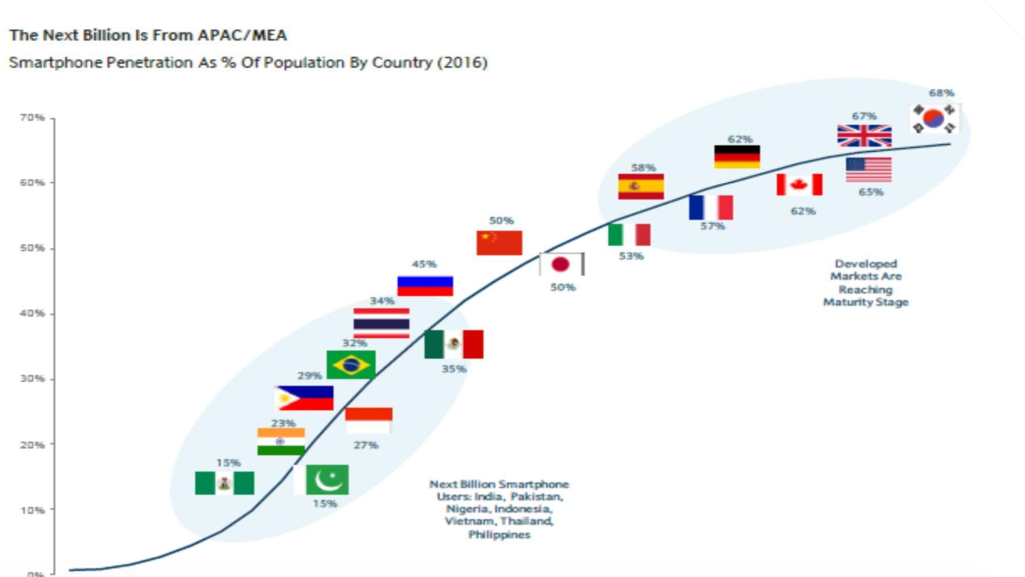
Internet users/Mobile users
Desktop Internet 600m In Western Markets, Mobile Internet 5B+ WW

Slide 5
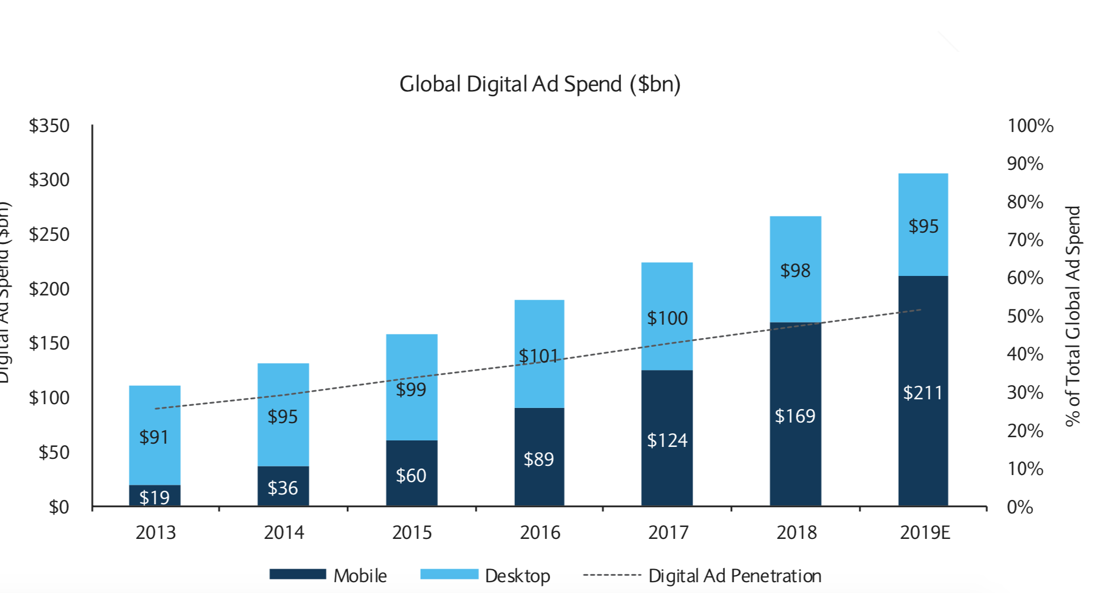

Slide 6
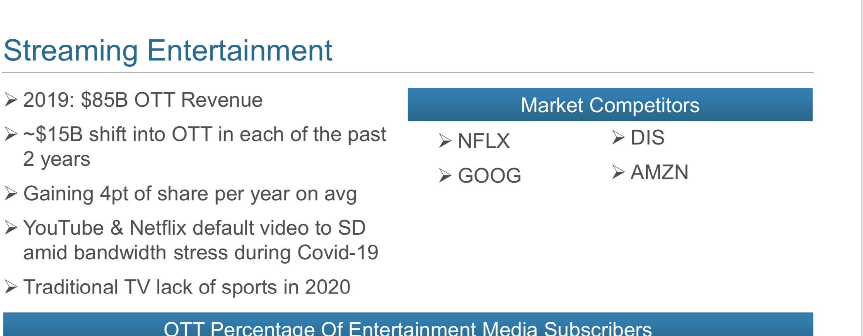

Slide 7
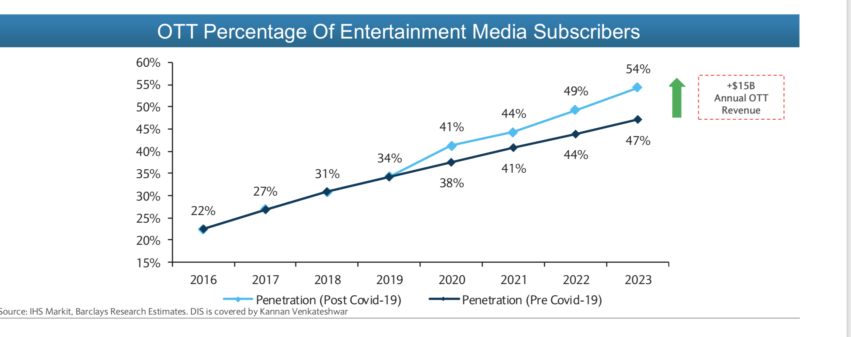

Slide 8
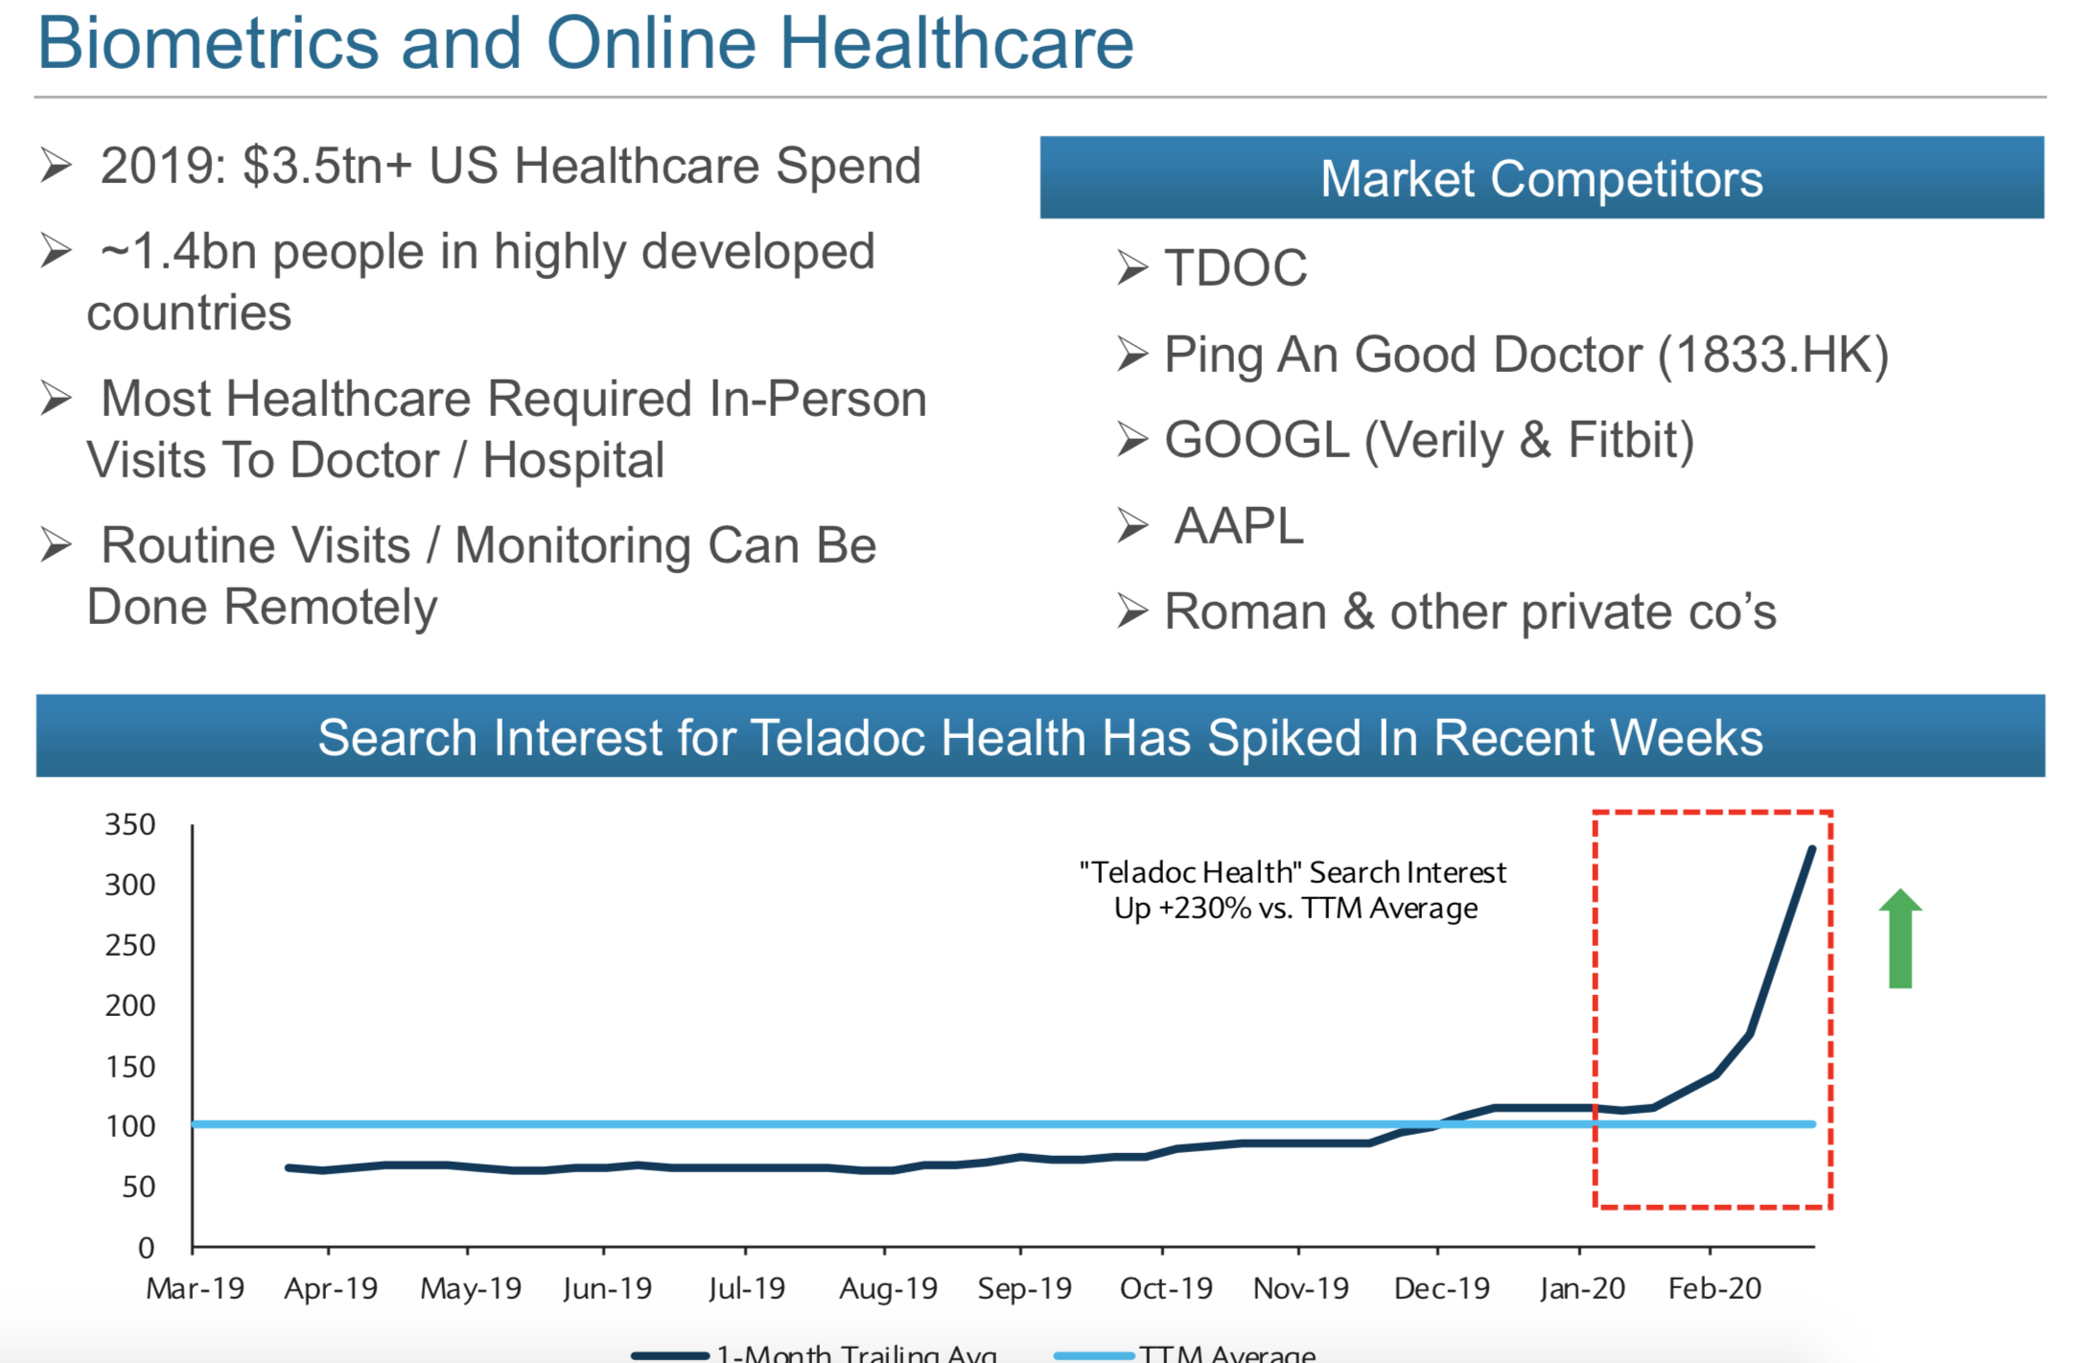

Slide 9
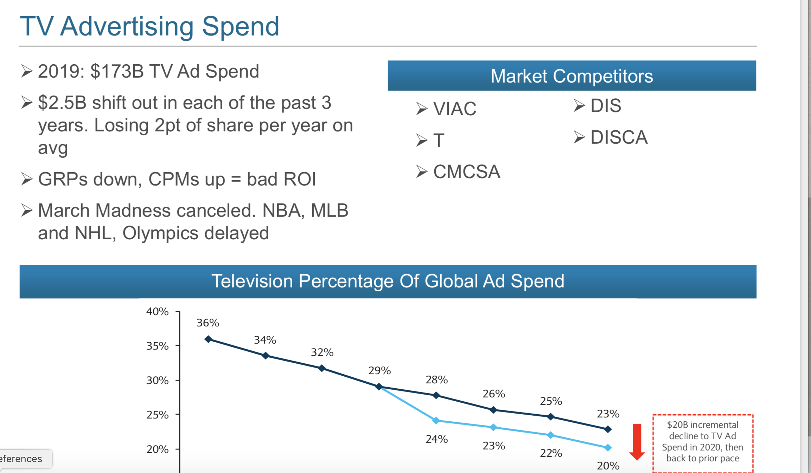

Slide 11
Google mission and Slogan
Google :
building a hopeful Google for everyone
Experience in lost cost phone company
Education in all classes
Free training (grow with Google)
Privacy and security for everyone
AI for veryone
TCAP ( train to detect the zebra)
Variable to decide
Concept of stripes is important preductor for moel
Picture od doctor, male wearing coat and stetocope
Skin - wide varietu of skin tone ( AI which is fair which)
Reducing bIas
Safe , secure and private (clear meaningful) - ignotio/ activity/ auto delete ( how long you wnat t be saved) odl data will be deleted

Slide 12
Google mission and Slogan (more helpful Google)
Igcognito in App ( places to search and will be saved in map )
Live transacript
Live caption
Understand eye expression and covert that in speech
Read different type of voice disablity ajd convert that in speech

Slide 13
Weakness
Hardware is their 2nd class citizen
Minimal physical presence
Relies on one source of income (ads)
Confusion in customer mind about multiple products
Android tv vs chromecast
Duo vs hangout vs meet
Youtube music vs google music
Lack of logistics chops
Increased scrutiny from regulators

Slide 14
android
innovation/security and privacy
On device learning
Privacy ( share)- activity/loaction
Security and privacy
File based encryption
Work profilles
Google play protect ( 60 millin apps)

Slide 15
Think BIG ideaa

Slide 16
Top Products
Chromebook
Calendar
Keep
Google drive
Google analytics
adsense
Adwords
GCP
YT Kids
Google trips
Google voice
Waze
Googel Fi
Google flights
Chromecast
Google groups
Classroom
Inbox
Waymo
Gmail
Google.com
Youtube
Google Maps
Google Photos
Google Hangout
Google Pixel
Android
Google Home
Cardboard VR
Google Wallet/Google Pay
Translate
Chrome
App store

Slide 17
Top technologies
Artificial Intelligence (AI) ...
Machine Learning. ...
Robotic Process Automation or RPA. ...
Edge Computing. ...
Virtual Reality and Augmented Reality. ...
Cybersecurity. ...
Blockchain. ...
Internet of Things (IoT)

Slide 18
Technology trends
Hyperautomation often results in the creation of a digital twin of the organization
https://www.gartner.com/smarterwithgartner/gartner-top-10-strategic-technology-trends-for-2020/

Slide 19
One technology you like
Artificial technology:
Artificial intelligence (AI) is the simulation of human intelligence processes by machines, especially computer systems.Specific applications of AI include expert systems, natural language processing (NLP), speech recognition and machine vision.
AI programming focuses on three cognitive skills: learning, reasoning and self-correction.
Because of AI, what are the microtrends:
Jobs. home. hospital . education
AI allow people through augmentation - engineering work
AI-driven voice assistant so lifelike and sophisticated that some found it astounding but others deemed it unsettling and wondered if a new era of robocall abuse just dawned.
AI driven robots
Notes:
https://searchenterpriseai.techtarget.com/definition/AI-Artificial-Intelligence

Slide 20
Why I like AI/UI?I
Decision tree:
4, 5 technology
Opportunities
Choose one technology
Are we most likely to execute (impact/alin with the Goal)
Solving pain points of multiple users
Simplity, innovative
Opportunities
Opening the lot of opportunities and it enables lot of treds
Opportunities of
Understanding human intentions
Machine get smarted to understand the pattern
Product: ( affect everyone and it is a real problem)
Jobs: office jobs/field jobs
Problem solving
Move stuff
Communicate:
Language: Translation is one of the common problem
Voice
AR
Senses and gesture.
Health issues
Autonomous driving
Food
Voice affects everyone
Notes:
https://searchenterpriseai.techtarget.com/definition/AI-Artificial-Intelligence

Slide 21
Machine learning

Slide 22
Job augmentation

Slide 23
Trends - technology (5-10 yrs)
IOT
5G
AI
Blockchain
Autonomous vehicles
VR/AR
3D printing
Video calling
Quantum computing
Better power/battery, storage, compute
Wearable
Health
Space related ?
Tunnels etc in transportation
Voice assistant
Translate
Robotics

Slide 24
Change in behavior
People will spend more time at home
Work hours to go down to 30 hrs/wk
MFG will be at home (3d printing)
Environment awareness
Virtual experiences
Events, celebrations, meetings, sports, travel
Online games will gain traction
Education will evolve
Health will be a focus
Privacy awareness
Smart cities
Custom medicine
Remote visitation (hospital, exams, DMV)
Technology dependency will be high
Pros/cons
Smart kitchen
Smart homes
Smart cities
People will be more technology aware
Elderly people can access smart devices
Ownership will decrease

Slide 25
What is 10X
What end purpose does this product solve
Why does the problem exist
Understanding the technology trends in next 10 years
How

Slide 26
DNA as data storage
Haptic design

Slide 27
Mop
Objective: Provide a clean environment in living spaces around them
Business Goal: Revenue
Users:
Spaces - Home, Commercial, vehicles, community
Who - Owners, professional cleaners
Since we believe people will spend more time at home - hence Home
Big home
User flow (cleaning): Awareness -> what to clean -> identify tools -> how -> maintenance -> storage
Pain point: Maintenance - time
Solution
Drone to deliver the cleaning tools and take it back for maintenance
Sensors and camera to detect dirt

Slide 28
Vending machine for blind
Focus on creativity
Different type of approach - voice/sensor/senses/directional gesture
This prototype has a voice synthesis and is based on making simple gestures on the screen.
The concept uses gestures instead of pointing and touching and is based on the user’s single directional stroke on the screen

Slide 29
Simplify products

Slide 30
System design - using a restaurant
Cloud computing
Park
Encryption
Envelope for a letter
Machine learning
Blockchain
Recursion
Function
BigO
Database - sql vs nosql
SQL - individual items in grocery store (join)
Pre-built recipe boxes
Map reduce
Counting a box of red and blue chocolates in a giant box
Kids (mappers) - get a section of the box and separate red and blue chocolates
Kids hand off red chocolate to the mom & blue to dad (reducers)
The parents (reducers) count the number of chocolates

Slide 31
Analysis

Slide 32
Google photos
Current challenges (for improvements)
Storage issue
Need to log in photos
Random selection of photos
Photos get compressed?
What will be true in 5-10 yrs
It will be more than photos and videos
AR on photos (see kid crawling on floor)
Millions of pictures
Augmented reality on photos
re- living the past
Live the experience with others
Solution
Relive the live/past via AR & VR experiences
For your own past
For someone else’s picture
Allow custom editing
Insights into the document
Take a picture and allow you to visit these scenes via VR
Personalised editing recommend best photo and clear the storage 2) maximum quality (better compression) 3) recognising the experiences (summarizing the exp)

Slide 33
Chromecast
Current challenges (for improvements)
What will be true in 5-10 yrs
Solution

Slide 34
Google doc
The Research Tool
The Research tool is a godsend for anyone writing something in Google Docs that requires online research. Why? It allows you to research and refer to information and images online without every having to leave the document. That means no more clicking back and forth endlessly between tabs.
Mission:Organise your content across all devices real time:With Google Docs, you can write, edit, and collaborate wherever you are. For Free
10X for Google doc

Slide 35
Google music
Challenges:
What is the future
AI will be creating music
New music is formed on the fly
Listen to music without headphones in shared spaces
Enjoy music in any language
Align mood of the room with the music

Slide 36
Google Calendar
Automatically schedule recurring meeting
Add meeting notes to calendar for easy search
Instruct calendar to make next week light or free up monday
Auto-schedule meetings with multiple people based on time and availability
Extend it for recurring meetings - when this is required for a different time slot
Build calendly functionality
Automatically call people, who requested call on phones
Analyze all meetings - report meeting patterns
Build a device like real life for seniors
Predict and propose meeting and activity e.g. when to go for a run or go out monthly with friends

Slide 37
Youtube
Predict & buffer videos based on browsing pattern
Auto-narration - e..g for blind or commuters
Search within a video for a scene
Same person multiple interest - detect interest predictability
Change language on the fly - caption and audio
Key highlights - summarize a big scene, sports or movie
Detect opinion - let people search based on opinion
Auto create video stories - based on articles and books
Autocreate training series & questions
Over 2 Billion logged-in users visit YouTube each month and every day people watch over a billion hours of video and generate billions of views. More than 70% of YouTube watchtime comes from mobile devices. YouTube has launched local versions in more than 100 countries.

Slide 38
Google Wifi
Local buffer for wifi
Qos on router
Send link to a friend to auto connect to guest wifi
Create user groups for security isolation
Kids - limited time, shut off after certain use,send reports
Intelligent firewall based on cloud based algorithm - and restrictions for kids etc
Stop it from external attacks
Add smart home protocols
Offload local compute from iot to the router

Slide 39
Google search
Auto summarize based on various search results (can this impact revenue)
Better understanding for context- for examples if you are looking for South America google understand that it would be animals
https://link.medium.com/5uzqZeqvi6

Slide 40
Gmail
Write complete email to responder - given a summary or intent
Calendar integration - to auto schedule appointments
Summarize a thread - either its long or old for context
Allow searching all attachments with some kind of faceted search
Get email analytics - who is sending the most email
Will this email get a response? Measure effectiveness

Slide 41
Google Home
Mission:
Goal : Business goal/User Goal : Google setting the trend.
Competition , Apple,Industry life cycle:
Segment for next 5 years: Segmentation, Targeting, and Positioning
threats/ weakness: developing worlds (pricing (demand/supply sides/distribution channels), product (better product), price , placement
Market segment: 4p:
To get the vision , merge with assistant

Slide 42
Google Home
Camera integration
Detect gesture
Google home for enterprise
Predicting what tasks a person should do and guide them proactively - e.g. would you like to order in food? Call your mom
Security
Health

Slide 43
gmail
Video email
Invite person to the VR world
Recyclable emails

Slide 44
Google maps
Book appointments for restaurants automatically
AR based experience - see the food before you visit
Route preferences based on historically patterns - take a specific route
Kids drop off considered during commute
Show crime report - for a location or along the route - avoid crime
Kid friendly route - safe, have food etc
Plan the entire trip for the user - based on stops etc
Commuter - propose daily best routes and times to leave
Kids status - report to parents, warn kids if in danger

Slide 45
Ads
YT - add save for later not just skip ad
YT - ads as content
AR experience - click pic to find the refrigerator
Purchase complete at google.com

Slide 46
WhatsApp
Image management
Event/Calendar management
Integration with photos
Business integration
Price quotes and payments

Slide 47
Google news

Slide 48
Google Assistant
Available on phone:
Manage task :Send a text, set reminders, turn on battery saver and instantly look up emails and more
Plan your dayCheck your flight status, find the quickest way to the airport by public transport or by car, play your favourite songs and find a coffee stop along your route.
Entertaintment:Play your latest songs, podcasts and control your music from your favourite media provider such as YouTube Music and Spotify.
Make memories: Your Assistant makes it incredibly simple to find your photos — and to take them as well.
Control your home:Use your phone to control your smart home devices. Adjust the temperature, lighting, and more, even when you’re not home.
Navigate your CAR: Ask your Google Assistant to start your commute and help you find the things you need on the go, such as petrol stations, restaurants, and stores
:

Slide 49
Google HArdware
Home: Nest ,Enhance your security. Get 10% off Nest Cam Indoor, Nest Cam Outdoor, or Nest Hello video doorbell, doorbellm alarm, Camera:Nest takes note of how you move around your house throughout the week, adjusting the various temperature settings according to the time of day and your habits. With the third-generation model, a new set of sensors called Farsight make this even more accurate.Farsight detects when you enter a room or walk past it up to five meters away, a significant improvement over earlier models. Additionally, up to 10 additional sensors can monitor temperatures in other rooms, further optimizing your heating and cooling. You can monitor temperature from a much farther distance thanks to a 3.25-inch screen, a half-inch bigger than previous model.Nest learns your patterns effortlessly. The Nest's main selling point is the way it learns your routine.The Nest Hub Max, for example, features a gesture to stop music by holding up your hand. It also has Face Match, which recognizes up to six household members and shows them personalized notifications. And then there's Auto Framing, which tracks your head movement and keeps it in the center of the screen during video calls. These features aren't in any other Google-powered smart display, much less Amazon's. It's a powerful advantage that Google has no qualms in wieldin
Auto Framing, in particular, is reminiscent of Facebook's Portal(where the camera follows your movements around the room), a feature that many reviewers said feels creepy.
PriVAcy concersn
Notes:
https://www.engadget.com/2019-05-09-google-nest-smart-home-privacy.html?guccounter=1&guce_referrer=aHR0cHM6Ly93d3cuZ29vZ2xlLmNvbS8&guce_referrer_sig=AQAAADlRkd_DW_amdMr29h8tsO389iwFJsJ3qhNG_yeGKv7xhqwpq7MsP6xDx0Js6fCGoP3-TUlP_LDVRRXbOYmKQ5JiHJ3MSKC-OhWdnrXzqyCaqwzaM22vKT-3mg93ru6zqjN02VgOoHznNmHzNOZZQvCur2YE4T3SkXfMOr3R5H0N

Slide 50
Android phone: pixel 4 and 5
Pixel state: Tablet
Chromecast:
Gaming:

Slide 51
Chrome
Faster :
2 time faster in javascript
Sites on faster
Images Lazy loading: loading all the images ( can waste theuser data) never actually,

Slide 52
Google home

Slide 53
Google Ads

Slide 54
Google chrome

Slide 55
Google plus

Slide 56
Google phone

Slide 57
Google cloud
Mission:Whether your business is early in its journey or well on its way to digital transformation, Google Cloud's solutions and technologies help chart a path to success. Grounbreaking solutions, transformative know how. “Solving is in our DNA.Let’s put that to work for you”
Features:
Competition
10X

Slide 58
Google cloud
ey 2019 themes to watch among the top cloud providers include:
Pricing power. Google raised prices of G Suite and the cloud space is a technology where add-ons exist for most new technologies. While compute and storage services are often a race to the bottom, tools for machine learning, artificial intelligence and serverless functions can add up. There's a good reason that cost management is such a big theme for cloud computing customers--it's arguably the biggest challenge. Look for cost management and concerns about lock-in to be big themes.
A blending of license, subscription and usage models from software vendors. Cloud computing used to equal subscription and usage based pricing, but Microsoft has moved toward blending models
Multi-cloud. A recent survey from Kentik highlights how public cloud customers are increasingly using more than one vendor. AWS and Microsoft Azure are most often paired up. Google Cloud Platform is also in the mix.
Artificial intelligence, Internet of things and analytics are the upsell technologies for cloud vendors. Microsoft Azure, Amazon Web Services and Google Cloud Platform all have similar strategies to land customers with compute, cloud storage, serverless functions and then upsell you to the AI that'll differentiate them. C
The cloud computing landscape is maturing rapidly yet financial transparency backslides. It's telling when Gartner's Magic Quadrant for cloud infrastructure goes to 6 players from more than a dozen.

Slide 59
You tube
YouTube, for example, one of our most important goals is in the engagement category: we want our users to enjoy the videos they watch, and keep discovering more videos and channels they want to watch
For YouTube Search, a key goal is in the task-success category: when a user enters a search, we want them to quickly and easily find the videos or channels that are most relevant.
Next, map your goals to lower-level signals . How might success or failure in the goals actually manifest itself in user behavior or attitudes? For example, an engagement signal for YouTube might be the number of videos users watch on the site — but an even better one might be the amount of time they spend watching those videos. A failure signal in the “Task Success” category for YouTube Search might be entering a query but not clicking on any of the results.
how long users spend watching videos” as “the average number of minutes spent watching videos per user per day.”
Notes:
https://library.gv.com/how-to-choose-the-right-ux-metrics-for-your-product-5f46359ab5be

Slide 60
Gsuite
Reach your colleagues wherever they are.
Gmail
Calendar
Currents
Google Chat
Google Meet
Everything you need to bring your project to life.
Docs
Sheets
Forms
Slides
Sites
Apps Script
Keep

Slide 61
Technology do you like

